Slide 1
Raid Storage
Week 12

Slide 2
RAID Technology: RAID is the technology of grouping several hard disk drives in a server into an array that can be defined as a single logical drive. This logical drive then appears to the operating system as a single physical drive. This grouping technique greatly enhances logical-drive capacity and performance.

Slide 3
What happens when data is lost
Hard drives and SSDs fail. It's not a matter of if — it's when. Studies by Google and Backblaze show:
~1.5–5% of drives fail per year
A data center with 10,000 drives can expect 150–500 failures every year — that's more than one per day
Without RAID, a single disk failure = total data loss or downtime. In cloud environments serving millions of users, this is catastrophic.
Example: Dell PERC, LSI MegaRAID cards in physical servers. Common in traditional data centers.

Slide 4
RAID
RAID – or Redundant Array of Independent Disks – is a type of storage that writes data across multiple drives within the same system.
Different configurations are expressed as numbers, such as RAID 0, RAID 1, or RAID 5.
Each RAID type gives users different benefits:
— increased performance,
— greater fault tolerance, or a combination of both
— depending on how it writes and distributes your data.

Slide 5
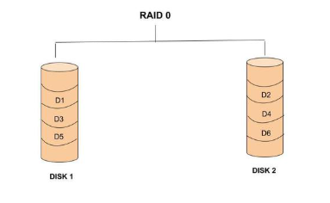
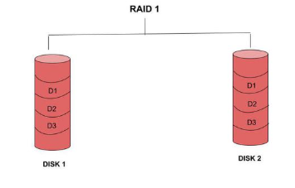
Key Concepts in RAID
Striping:
Data split into blocks and distributed across disks (RAID 0). Enhances performance.
Mirroring:
Duplicate data on two or more disks (RAID 1). Ensures redundancy
Parity:
Mathematical checksum is calculated from your data used to rebuild lost information (RAID 5/6). XOR operations for single parity (RAID 5), dual parity for RAID 6.

Slide 6
Parity Function in RAID
The parity function is a mathematical operation (typically XOR - Exclusive OR) applied to data blocks across multiple disks to generate a parity block. This parity block is used to reconstruct lost data in case of a disk failure.
Disk 1: 1 0 1 1
Disk 2: 0 1 1 0
Parity: 1 1 0 1 ← XOR of Disk1 and Disk2
If Disk 2 fails:
Disk 1 XOR Parity = 0 1 1 0 ← Disk 2 reconstructed!

Slide 7
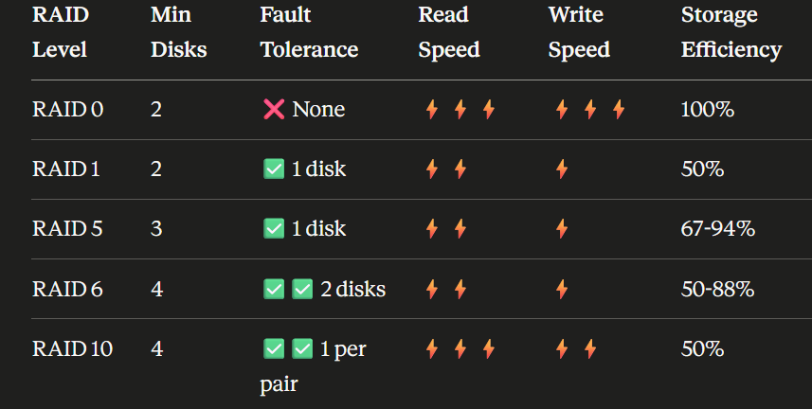
RAID Types
Raid 0:
Raid 1:
Raid 5:
Raid 6:
Raid 10

Slide 8
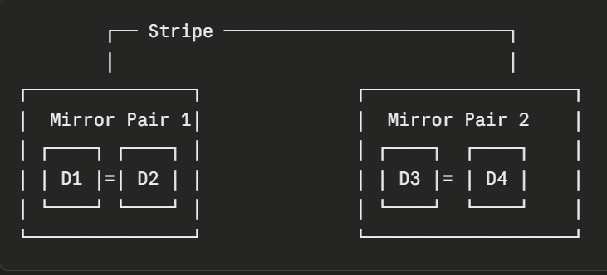
RAID (10)= 1+0
RAID:
Mirroring + striping combined.
Notes:
High-traffic databases (MySQL, PostgreSQL)

Slide 9
Cloud with Raid Technology
Azure RAID concepts as replication tiers:
LRS (Locally Redundant Storage) ≈ RAID within one data center
3 copies, same building
ZRS (Zone Redundant Storage) ≈ RAID across Availability Zones
3 copies, different buildings/zones in same region
GRS (Geo-Redundant Storage) ≈ RAID across continents
6 copies: 3 local + 3 in another continent
Can withstand entire regional disasters

Slide 10
Performance tuning
Different chunk size.
More overhead with small chunk size(databases), less overhead with large chunk size(video streaming).
Read Ahead Caching:
RAID controller and cloud storage uses read ahead to predict what data you will need next.
For example: You read Block 5
System thinks: "They'll probably want Block 6, 7, 8 next"
System pre-fetches: Blocks 6, 7, 8 into cache
Result: Next reads are near-instant
Write Back vs Write Through cache:
Cloud use battery-backed or nvRAM cache

Slide 11
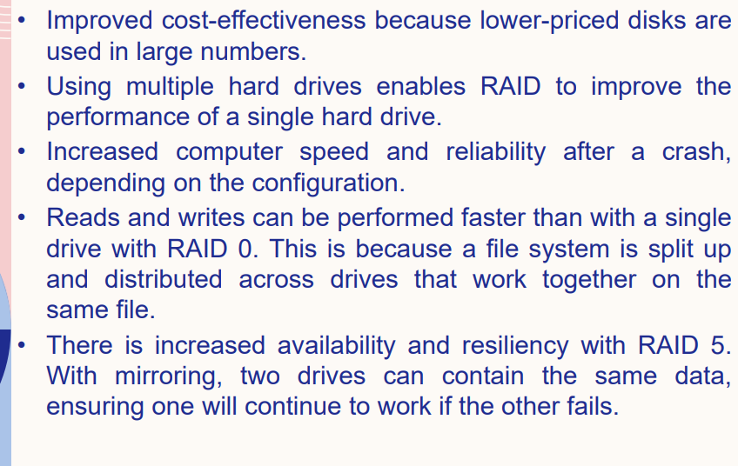
Advantages of RAID

Slide 12
Class Task: How does Google use RAID technology ?

Slide 13
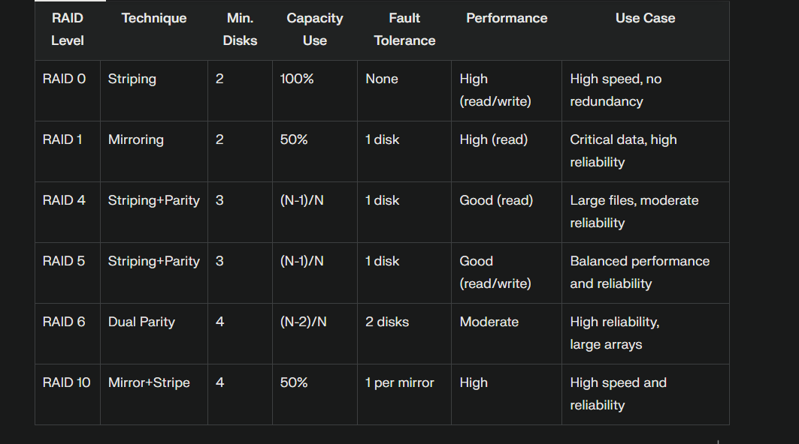
RAID Levels
Different configurations balancing speed, capacity, and reliability.

